Slide 1
VAWA and the Fair Housing Act

Slide 2
What is VAWA?

Slide 3
What is VAWA?

Slide 4
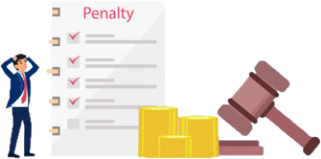
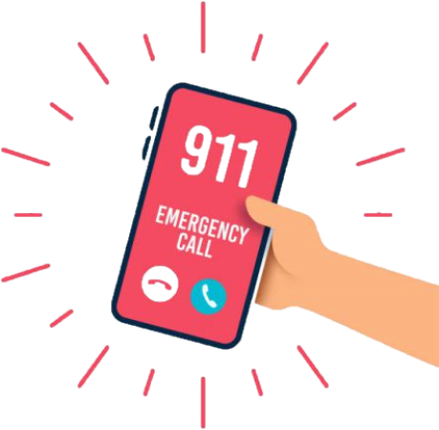
Reauthorization of VAWA
2000
- 2005
- 2012
- 2019
- 2022

Slide 5
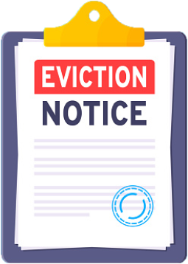
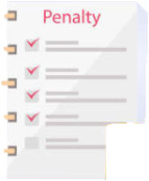
Reauthorization: Right to Report

Slide 6
Reauthorization: New Requirements

Slide 7
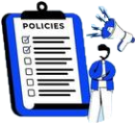
CDBG Requirements

Slide 8
VAWA & The Fair Housing Act
Fair Housing Act

Slide 9
Assessing Policies & Ordinances for AFFH

Slide 10
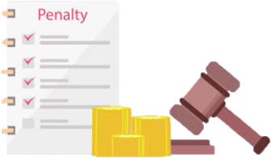
What are Crime-Free Housing Ordinances?
?
Zero Tolerance

Slide 11
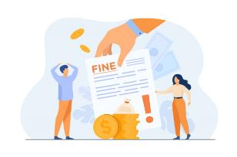
What are Nuisance Ordinances?
Nuisance Ordinance -
Local codes which label various types of conduct associated with a property as a nuisance

Slide 12
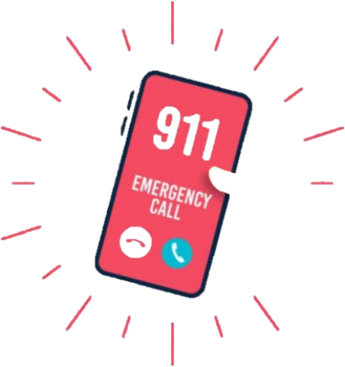
Nuisance Conduct Example: Veronica
5x / year
citation

Slide 13
Domestic Violence Examples: Kelly & Sheila

Slide 14
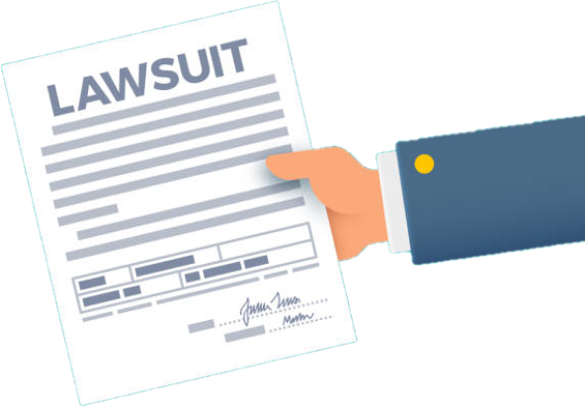
Three Strikes & “You Are OUT!”

Slide 15
How Litigation Arises
x
NOTE!
CDBG is not describing certification requirements

Slide 16
Question or Comments
https://www.nhaustin.com/training-and-certifications/course-outline/id/1000401014/c/adobe-indesign-cc-part-1

Slide 17
Additional Resources
VAWA Right to Report from Home for CDBG Recipients Webinar
https://www.hudexchange.info/trainings/courses/vawa-right-to-report-from-home-for-cdbg-recipients-webinar/4780/
HUD VAWA webpage
https://www.hud.gov/VAWA
Office on Violence Against Women (OVW) webpage
https://www.justice.gov/ovw

